Slide 1
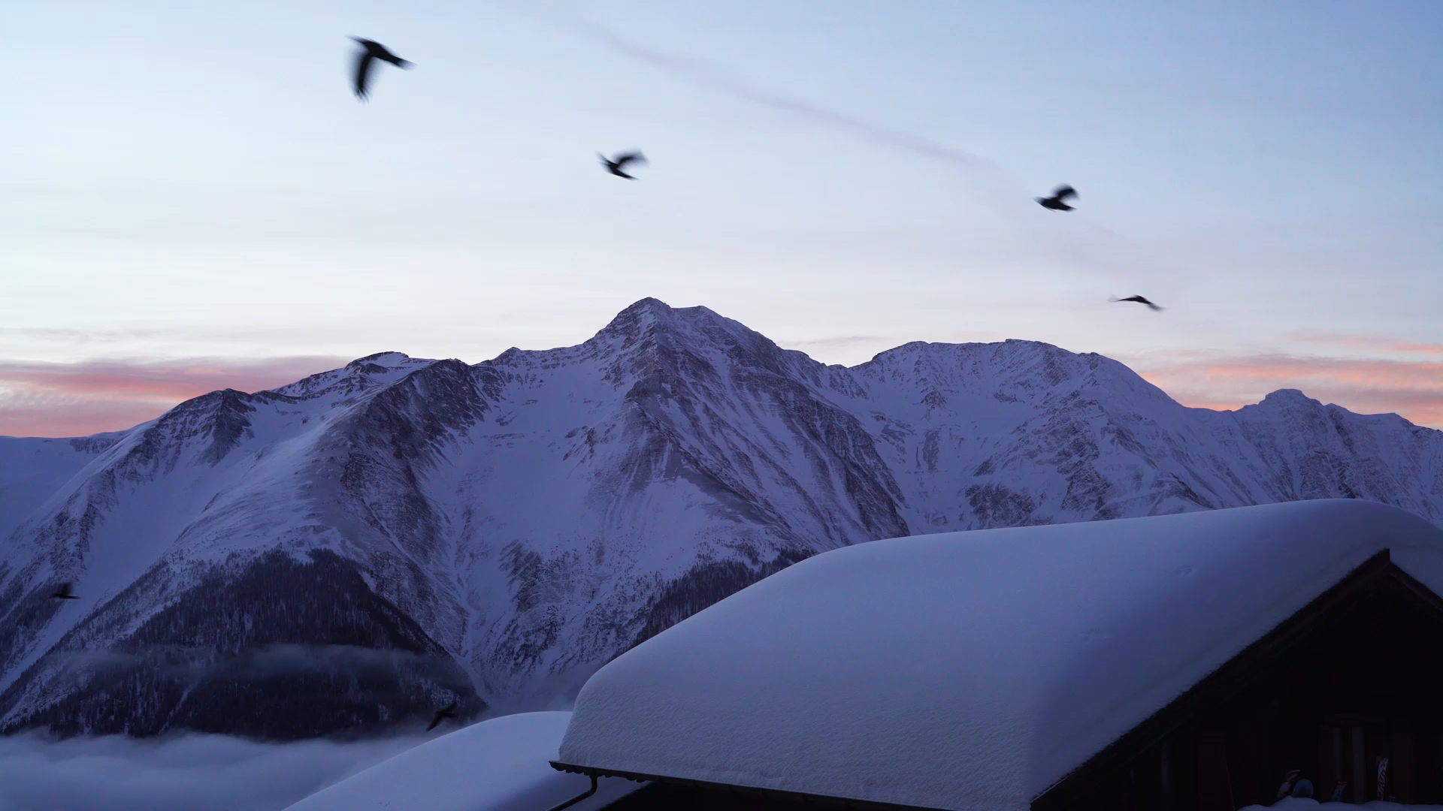
Big Mountain Resort
Guided Capstone 1
Muhammad A. Hannan

Slide 2
Problem Statement & Backstory
How can Big Mountain Resort maintain their profit margin of 10% or more for next year, by adjusting their ticket prices, operational costs, because of the additional added chair, that increased their operational cost by $1.54M?
Big Mountain Resort offers spectacular views of Glacier National Park and Flathead National Forest, with access to 105 trails. Every year about 350,000 people ski or snowboard at Big Mountain. This mountain can accommodate skiers and riders of all levels and abilities. The Business has expressed its desire to generate more revenue by raising ticket prices, or cutting down on operational cost, but does not know what and how much to raise/cut prices/operational cost.

Slide 3
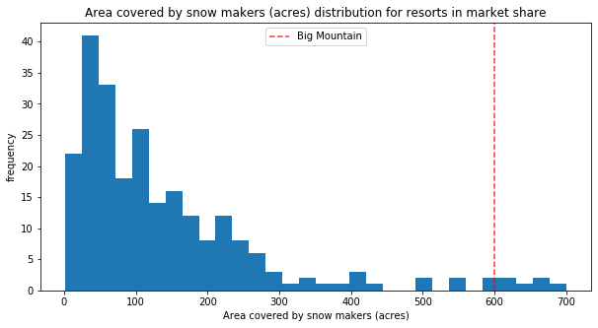
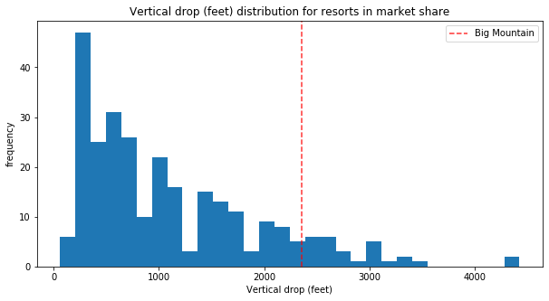
Resources
Big Mountain is very high up the league table of snow making area.
By adding
one run,
one more chair
increasing the vertical drop by 150 ft,
would give us an incentive to raise prices, average around $8.46 more to the price we currently charge. Over the season, we can expect an increase of $14,811,594 to our revenue.

Slide 4
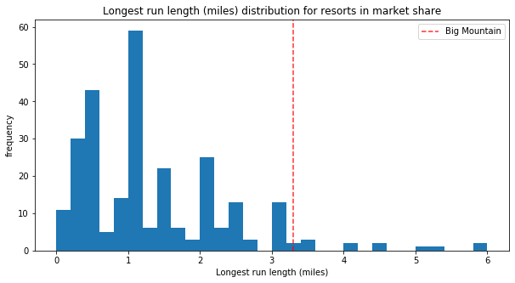
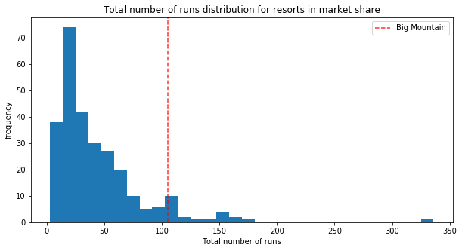
Resources
Big Mountain has one of the longest runs. Although it is just over half the length of the longest, the longer ones are rare.
Big Mountain compares well for the number of runs. There are some resorts with more, but not many.
This also gives us an incentive to reduce the number of runs, which will result in reduction of our operational cost.

Slide 5
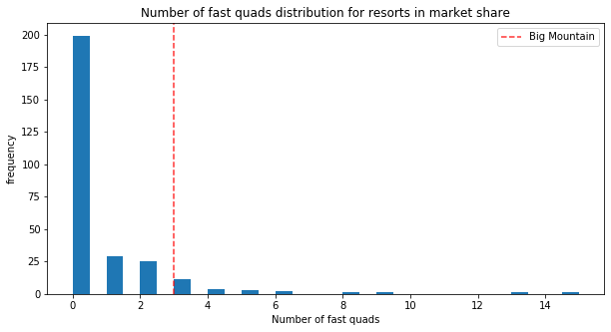
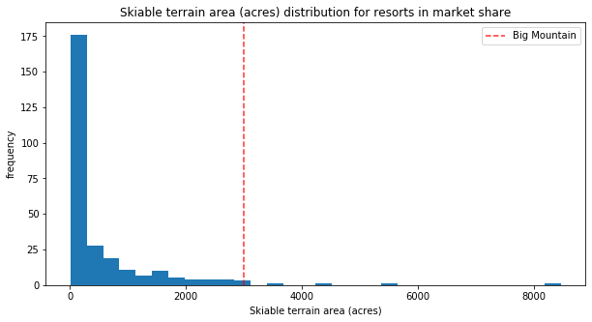
Resources
Most resorts have no fast quads. Big Mountain has 3, which puts it high up that league table. There are some values much higher, but they are rare.
Big Mountain is amongst the resorts with the largest amount of skiable terrain.

Slide 6
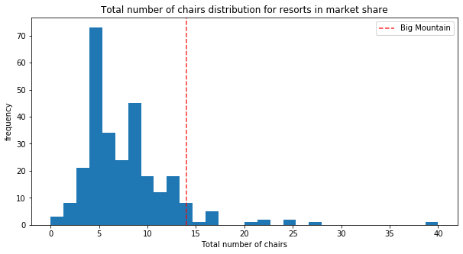
Resources
Big Mountain is very high up the league table of snow making area.
Big Mountain has amongst the highest number of total chairs, resorts with more appear to be outliers.
Our model also indicated that if we added:
2 acres of snow
Increased our drop by 150 ft
One chair
One run
We can increase our prices by $9.75, which over the season will accumulate to around $17,068,841 of additional revenue.

Slide 7
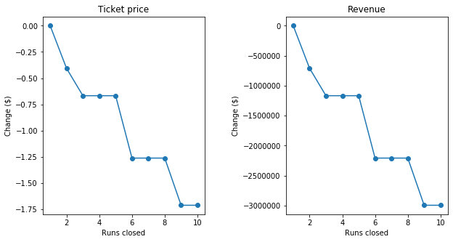
Resources
Big Mountain compares well for the number of runs. There are some resorts with more, but not many.
Our model suggested that closing one run makes no difference. Closing 2 and 3 successively reduces support for ticket price and so revenue. If Big Mountain closes down 3 runs, it seems they may as well close down 4 or 5 as there's no further loss in ticket price. Increasing the closures down to 6 or more leads to a large drop.
We will lose around $1.25M in revenue by closing 5 runs, however we will save from the reduction in the operational cost that comes with the runs.

Slide 8
Missing Data
Our prices model is based on Weekend prices only, due to having about 16% of data missing in the Weekday prices column, it made it hard for us to use that in our model.
We still do not know the total operational cost, which covers some essential features such as cost for runs, snow making area, etc. Since those were the essential features in our model, it would be great to have them.
We also only used Weekend prices in our model to explain the picture to us, incorporating Weekday prices can prove vital to better our model.

Slide 9
Conclusion
Our model suggests that the Big Mountain resort needs to have a dynamic pricing strategy, having different prices for weekends and weekdays would really boost up the revenue.
Also, our actual prices are short of the modeled price, $13.22 ($94.22 modeled price - $81 actual price) to be exact, therefore we have reason to raise our prices without adding any features.
With features, if we add one run, 150 ft vertical drop, one chair, our model suggests that gives us room to raise another $8 to our prices, which generates $14M revenue over the season.
If we add another 2 acres of snow to this scenario, the room extends to $9.75, which over the season accumulates to an additional $17M in revenue.

